Slide 1

REST API
Chapter 1 – What is REST API?

Slide 2
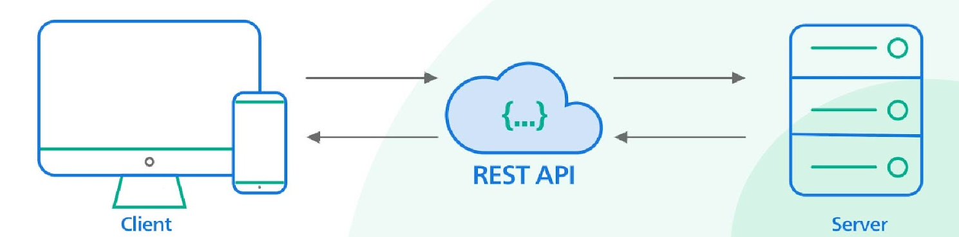
1.1. What is REST API?
LinkedIn Lesson: Chapter 1 What is REST API?
https://www.linkedin.com/learning/learning-rest-apis/welcome
The RESTful librarian
What is a REST API?
Sidebar: URL vs. URI
The six constraints of REST
How REST relates to HTTP
Who or what interacts with REST APIs?
Online Overview Tutorial
https://www.w3schools.in/restful-web-services/intro
Source: https://blog.bytebytego.com/p/why-is-restful-api-so-popular
© 2024 Web Age Solutions All rights reserved

Slide 3
1.2 REST API
REST API
The RESTful librarian
Example in video lecture
REST
Representational State Transfer and Application Programming Interface
REST API receives requests from clients
Process requests
Send requests to server
Receive responses from servers
Process responses
Send responses to clients
REST API takes care of request and response headers, body
Where is the resource?
URL
URI
How to invoke the resource operation?
GET
POST
PUT
DELETE
What type of Data transfer in request and responses?
JSON
XML
Plain text
MIME-Type
© 2024 Web Age Solutions All rights reserved

Slide 4
1.3 URL Vs URI
URL
Universal Resource Locator
Uniform Resource Locator
URI
Universal Resource Identifier
Uniform Resource Identifier
compact sequence of characters "that identifies an abstract or physical resource”
provides a simple and extensible means "for identifying a resource”
URN
Universal Resource Name
Uniform Resource Name
Examples: Identify the URL, URI in the examples
See the URL and URI in the following examples
https://docs.flightapi.io/
What is API URL ?
What is one way API ?
What is round trip API?
https://finnhub.io/docs/api
https://www.weatherapi.com/api.aspx

Slide 5
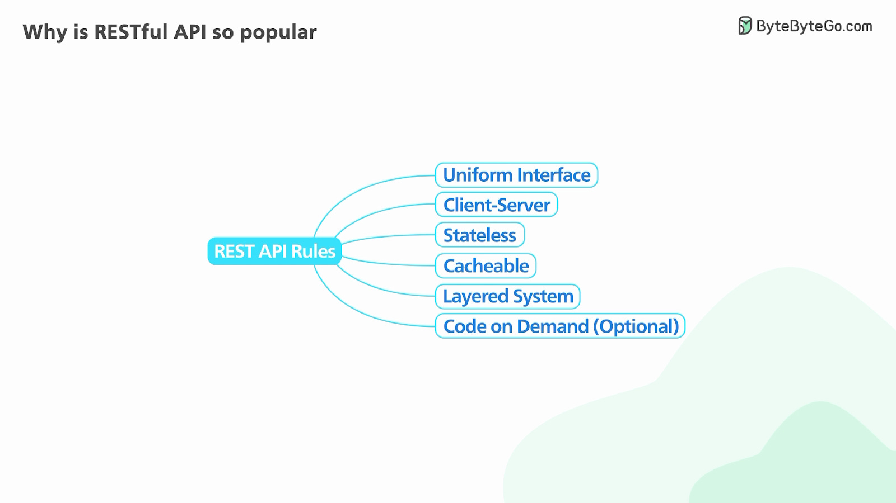
1.3 Constraints of REST
Constraints of REST
Six constraints
Client – Server Architecture
Ensures proper separation of concerns
Client manages user interface concerns
Server manages data storage concerns
One REST can serve many different clients and interfaces
Statelessness
Client Session state is not stored or managed by server
Client responsibility to keep track of session states
All requests from client must be self contained and complete
Cacheable OR Cache capability
All REST responses must be marked cacheable or non-cacheable
Layered System
Design a system where client may not know whether it connects to server or intermediary or CDN
Scalable and secure
Code on Demand
Servers can transfer executable code (JS or compiled components, client can customize
Uniform Interface
A uniform interface must use resource identification in requests

Slide 6
1.4 More on REST Concepts
Use HTTP Protocol to work with REST APIs
Use HTTP methods
Send HTTP request and HTTP Response
Who or What interacts with REST APIs?
Web clients
Desktop clients
Server applications to Cloud APIs
Social media
Cloud based computing
Google API Explorer
https://developers.google.com/apis-explorer
Microsoft REST API Browser
https://learn.microsoft.com/en-us/rest/api/
AWS API Gateway- REST API
https://docs.aws.amazon.com/apigateway/latest/developerguide/apigateway-rest-api.html
Tools to see REST API in Action
Postman
SOAP UI
https://www.integrate.io/blog/top-rest-api-tools/
See the tools

Slide 7
REST API
Chapter 2 – Request

Slide 8
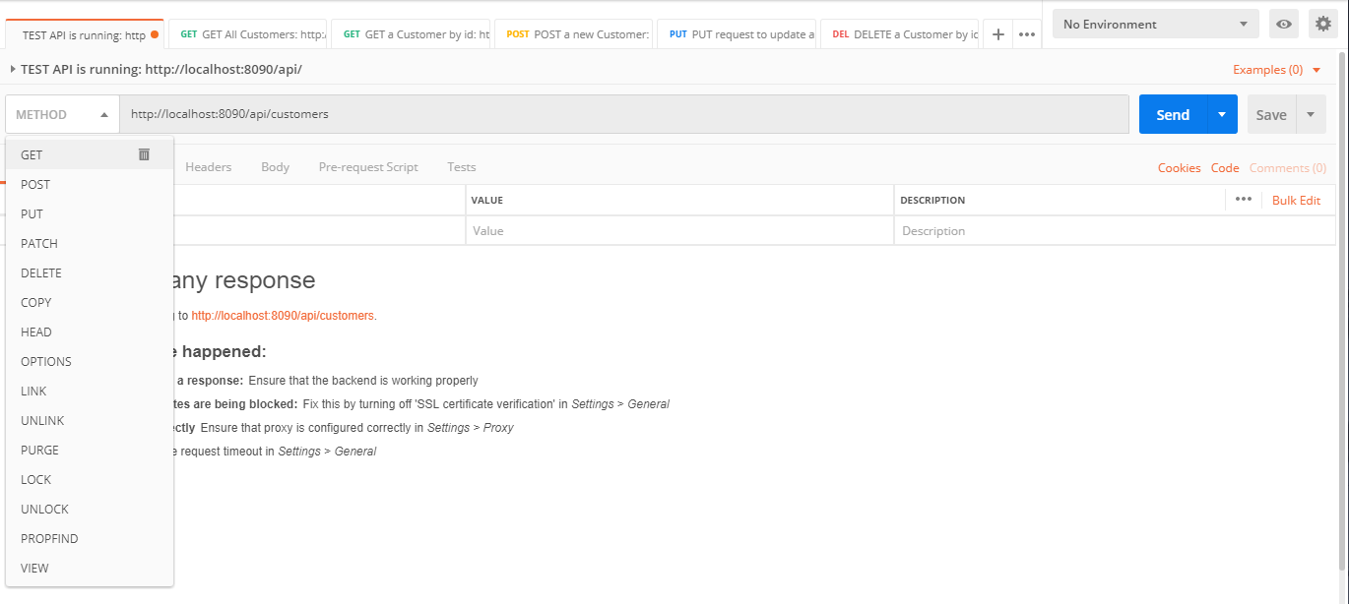
2.1. Anatomy of the REST Request
REST Request
Two parts
A method
A URI
Some methods may need request body
Methods
GET
POST
PUT
DELETE
HEAD
PATCH
URI
Points to the resource to interact with
Examples
GET site.com/wp-json/wp/v2/posts
GET /api/customers
POST /api/customers
PUT /api/customers/2
DELETE /api/customers/1
© 2024 Web Age Solutions All rights reserved

Slide 9
2.2. Discovery
Discovery is a key step when working with a REST API
API URI
Operations
Parameters
Query String
Input data types
Output data types
Any Security Key
Constraints
A good REST API has extensive standalone documentation, providing all this information in a human-readable format
Examples of API Documentation
https://openweathermap.org/api/one-call-3
https://docs.flightapi.io/flight-tracking-api
https://finnhub.io/docs/api/symbol-search
© 2024 Web Age Solutions All rights reserved

Slide 10
2.3. Resource
A REST resource
Domain object or resource
Customers
Flights
Products
Reservations
Any Business domain object
Create a new Resource at a specific location
POST URI
Send resource data
Resource representation: JSON, XML
Retrieve a collection of resources or a single resource
GET URI
Returns the resource collection or a resource
Resource representation: JSON, XML
Update an existing resource using a unique identifier
PUT URI
Send updated resource data
Resource representation: JSON, XML
Delete an existing resource using a unique identifier
DELETE URI
© 2024 Web Age Solutions All rights reserved

Slide 11
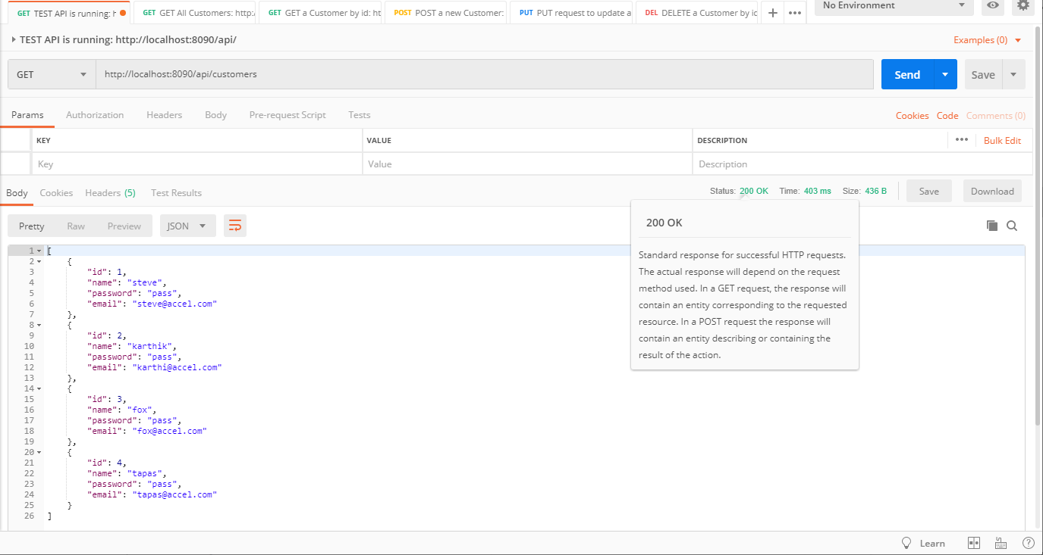
2.4. Response Code
Request processed successfully
HTTP status code 200 OK
Resource Not Found
HTTP status code 404 Not Found
https://developer.mozilla.org/en-US/docs/Web/HTTP/Status
Class Exercise: How to interpret the following status codes?
401
402
403
404
405
500
201
204
© 2024 Web Age Solutions All rights reserved

Slide 12
REST API
Chapter 3 - Response

Slide 13
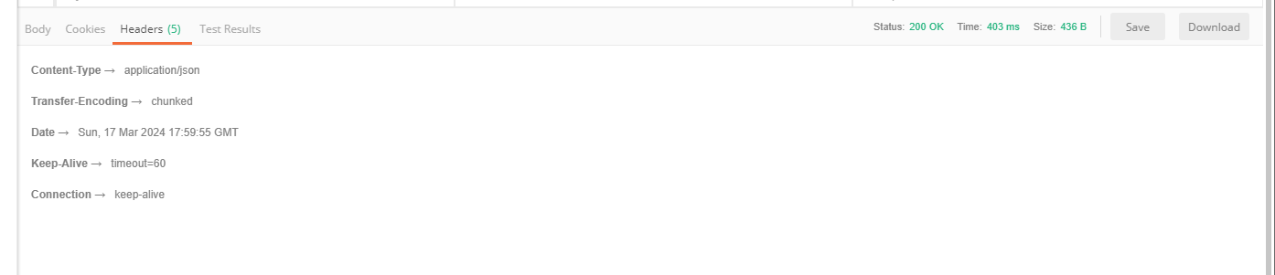
3.1. Response Header
Response
Header
Body
Cookies
.
Response Header
Content-Type
Transfer-Encoding
Date
Keep-Alive
Connection
Response Status
Time and Size
Content-Type →application/json
Transfer-Encoding →chunked
Date →Sun, 17 Mar 2024 17:59:55 GMT
Keep-Alive →timeout=60
Connection →keep-alive
© 2024 Web Age Solutions All rights reserved

Slide 14
3.2. Response Status Demo
Request processed successfully
HTTP status code 200 OK
Resource Not Found
HTTP status code 404 Not Found
https://developer.mozilla.org/en-US/docs/Web/HTTP/Status
Class Exercise: How to interpret the following status codes?
401
402
403
404
405
500
201
204
© 2024 Web Age Solutions All rights reserved

Slide 15
3.3. REST Authentication and Authorization
Authentication
Who are You?
Identification and authenticaton
User Name and password mechanism
API Key
Token authentication
Authorization
What can You do?
Access Control
Role Based Access control (RBAC)
Example
Login
Get a JWT Token for authenticated user
Submit all requests with JWT token
Allow to access only GET and POST requests
© 2024 Web Age Solutions All rights reserved

Slide 16
REST API
Chapter 4 – Request/Response Pairs

Slide 17
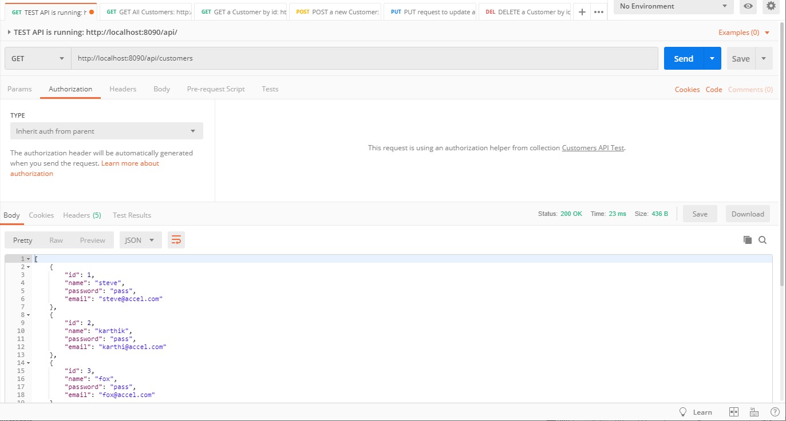




4.1. Get a Resource - GET
GET Request
Method: GET
URI
Parameters
Authorization
Headers
MIME-TYPE
GET Response
Headers
MIME-TYPE
Status Code
Size
Body
Cookies
© 2024 Web Age Solutions All rights reserved

Slide 18
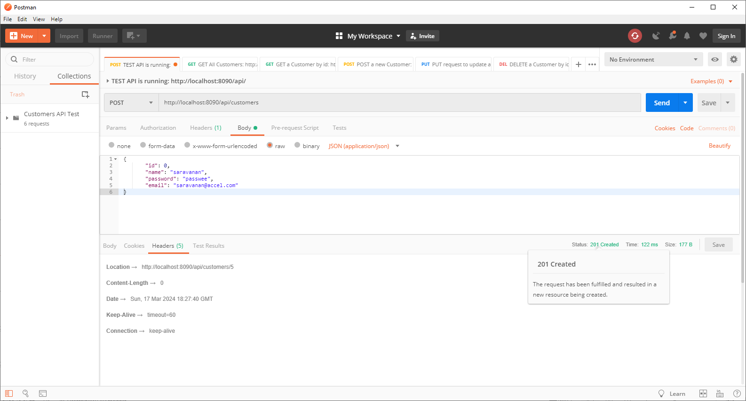





4.2. Create a Resource - POST
POST Request
Method: POST
URI
Authorization
Headers
MIME-TYPE
Body
Payload data
POST Response
Headers
MIME-TYPE
Status code
Size
Body
Cookies
© 2024 Web Age Solutions All rights reserved

Slide 19
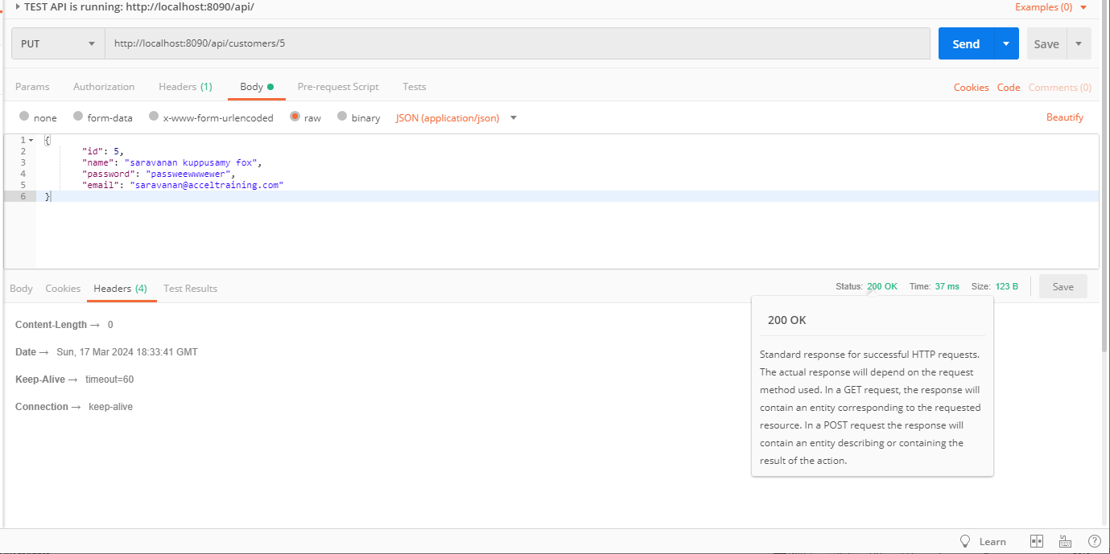






4.3. Update a Resource - PUT
PUT Request
Method: PUT
URI
Authorization
Headers
MIME-TYPE
Body
Payload data
PUT Response
Headers
MIME-TYPE
Status code
Size
Body
Cookies
© 2024 Web Age Solutions All rights reserved

Slide 20
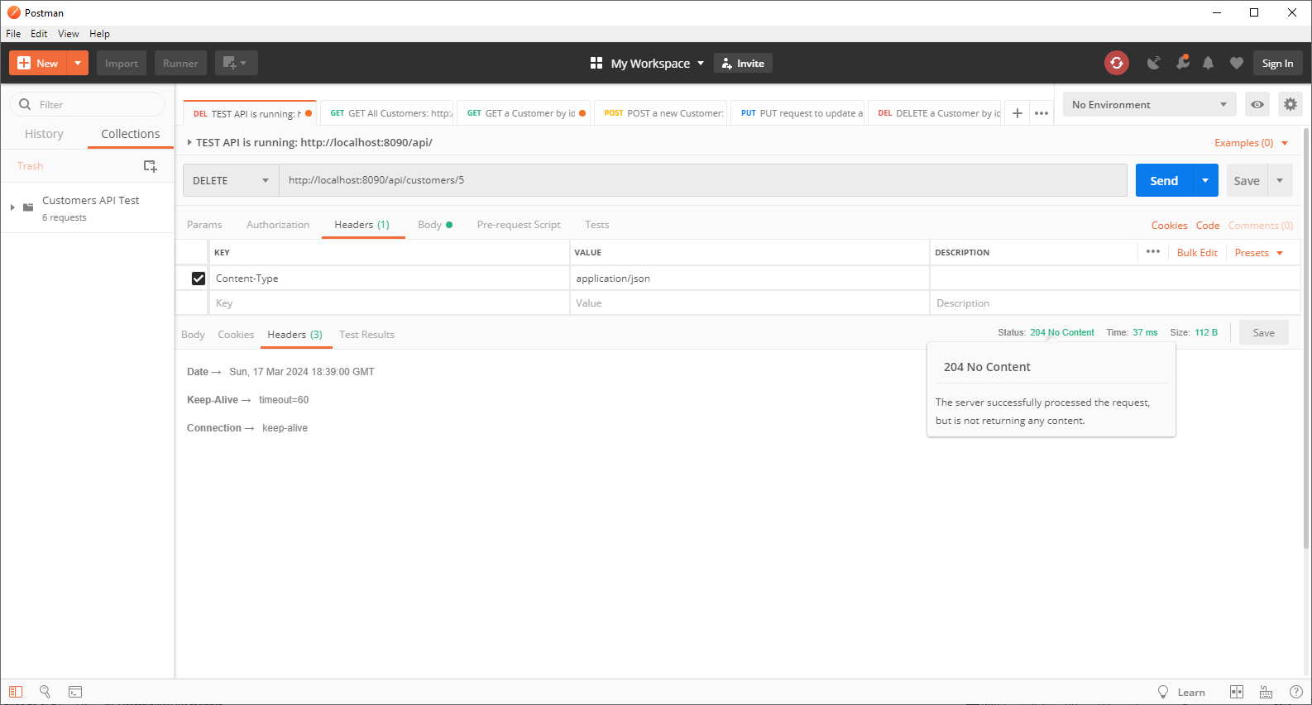








4.4. Delete a Resource - DELETE
DELETE Request
Method: DELETE
URI
Authorization
Headers
MIME-TYPE
DELETE Response
Headers
Status code
Size
Cookies
© 2024 Web Age Solutions All rights reserved

Slide 21
Additional Reading and Examples to Play
Review the following online tutorials about RESTful Web Services
https://www.w3schools.in/restful-web-services/intro
https://www.geeksforgeeks.org/rest-api-introduction/
https://blog.bytebytego.com/p/why-is-restful-api-so-popular
https://www.freecodecamp.org/news/learn-rest-apis-javascript-project/
© 2024 Web Age Solutions All rights reserved

